Slide 1
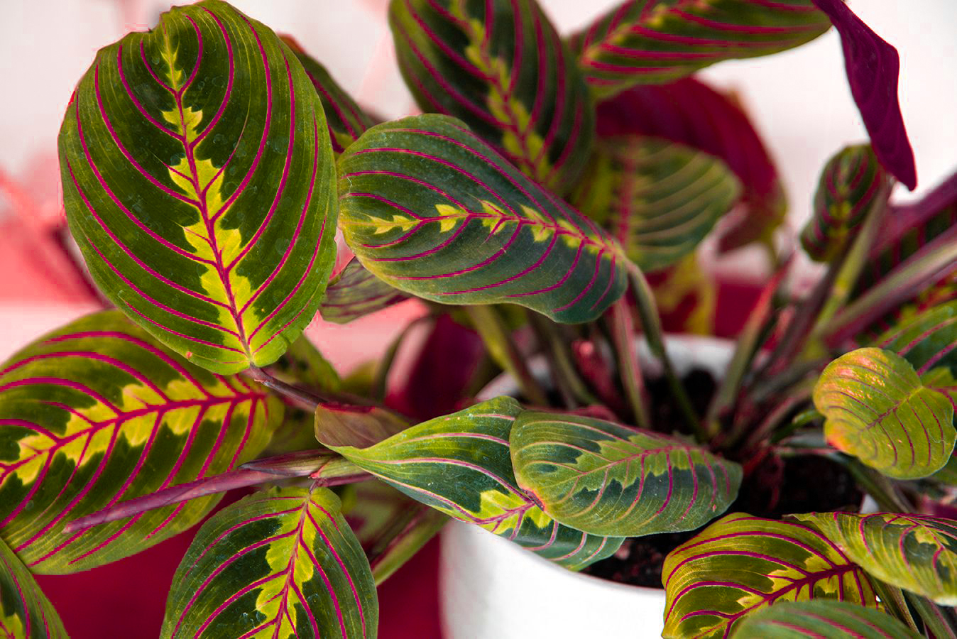
Plant Diseases Identification
Team Mate
Short Circuit
Member
Nirmal Kumar
Hema Kumar

Slide 2

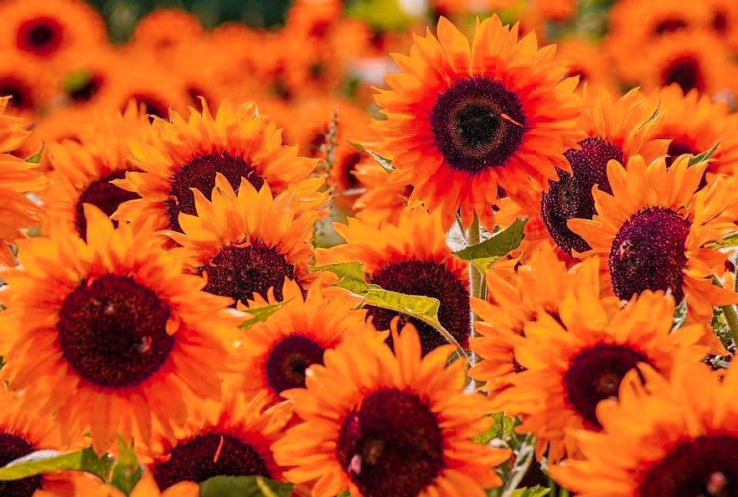
Plant Diseases Identification
Requriments
Python (tensor flow)
OpenCv
Meachine Learning
API
Smartphone
APK

Slide 3
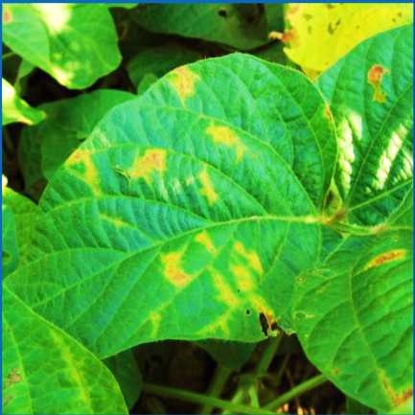
INTRODUCTION
Automatic plant image identification is the most promising solution towards bridging the botanical taxonomic gap. Which Receives Considering attention in both botany and computer community. As the Machine Learning technology advances, sophistication model have been proposed for automated plant identification. With popularity of Smartphone.
BJFU DataSet
The BJFU Dataset image set collection from natural scence Building Blocks {F(x)+x} it Consists of 100 species of ornamental plants in each category contain one hundred different photo acquiring by smartphone in natural environment. From equivalent focal length and Argb Sensor Resolution image then each pixel classification RGB color focus to Output
Image processing
Image Segmentation
Features Extraction
Classification
Output

Slide 4
Conclusion
The first mobile device acquired BJFU dataset containing 10,000 images of 100 plant species which provides data pillar stone for further plant identification study. We continue to expand the BJFU100 dataset by wider coverage of species and seasonsThis work also studied a Meachine learning approach to automatically discover the representations needed for classification, allowing use of a unified end-to-end pipeline for recognizing plants in natural environment.
The proposed model ResNet26 results in 80%-91.78% accuracy in test set
demonstrating that deep learning is the promising technology for large-scale plant classification in natural environment.
In future work, the BJFU100 database will be expanded by more
plant species at different phases of life cycle and more detailed
annotations. The deep learning model will be extended from
classification task to yield prediction, insect detection, disease
segmentation, and so on.

Slide 5

THANK YOU!

